Slide 1
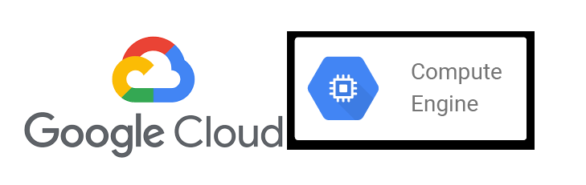

Google Compute Engine Provider
Participants:
Chethan BG
Rekha Kumari

Slide 2
Google Compute Engine
What is webMethods CloudStreams Provider for Google Compute Engine and its capabilities
Google Compute Engine provider can be used for virtual machines (VMs) instance, firewall, disk and image management.
This Connector lets you create , start, stop, suspend or delete VMs on Google’s infrastructure.
With this Connector you can retrieves the list of managed instance groups and groups them by zone.
The connect can be used for create and delete the firewall rules on GCP. Even it can fetch all the firewall rules.
Persistent disks are required for running your VM instances. This connector can be used to create, list and delete persistent disks.
You can use images to create boot disks for your VM instances. This connector let you to create, delete images. It can also retrieve the list of custom images
It can fetch internal and external IPs of VM instance.
It enables health checking mechanisms that determine whether backend instances respond properly to traffic.
This provider can be used to automate VMs maintenance activities.

Slide 3
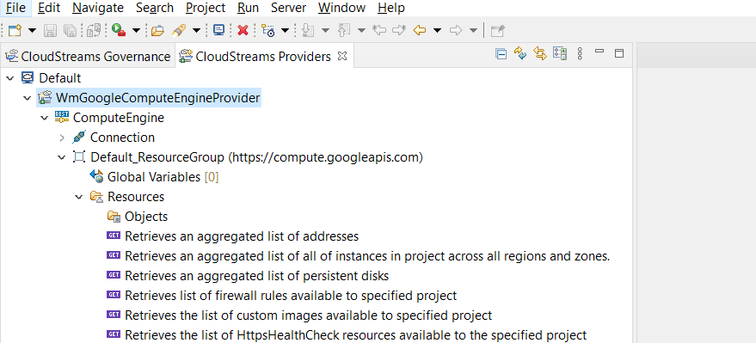
Screenshot of REST Resources

Slide 4
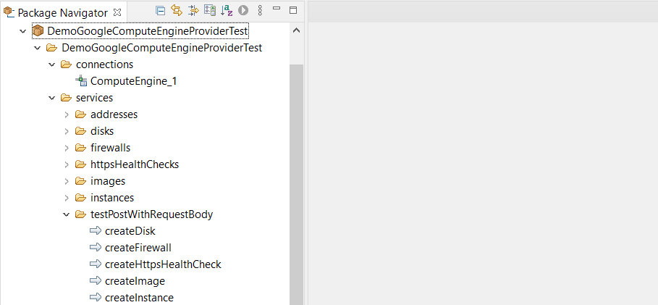
Screenshot of flow services

